Slide 1

Web Scraping Ufc stats
Kevin Glugar | Data Analyst

Slide 2
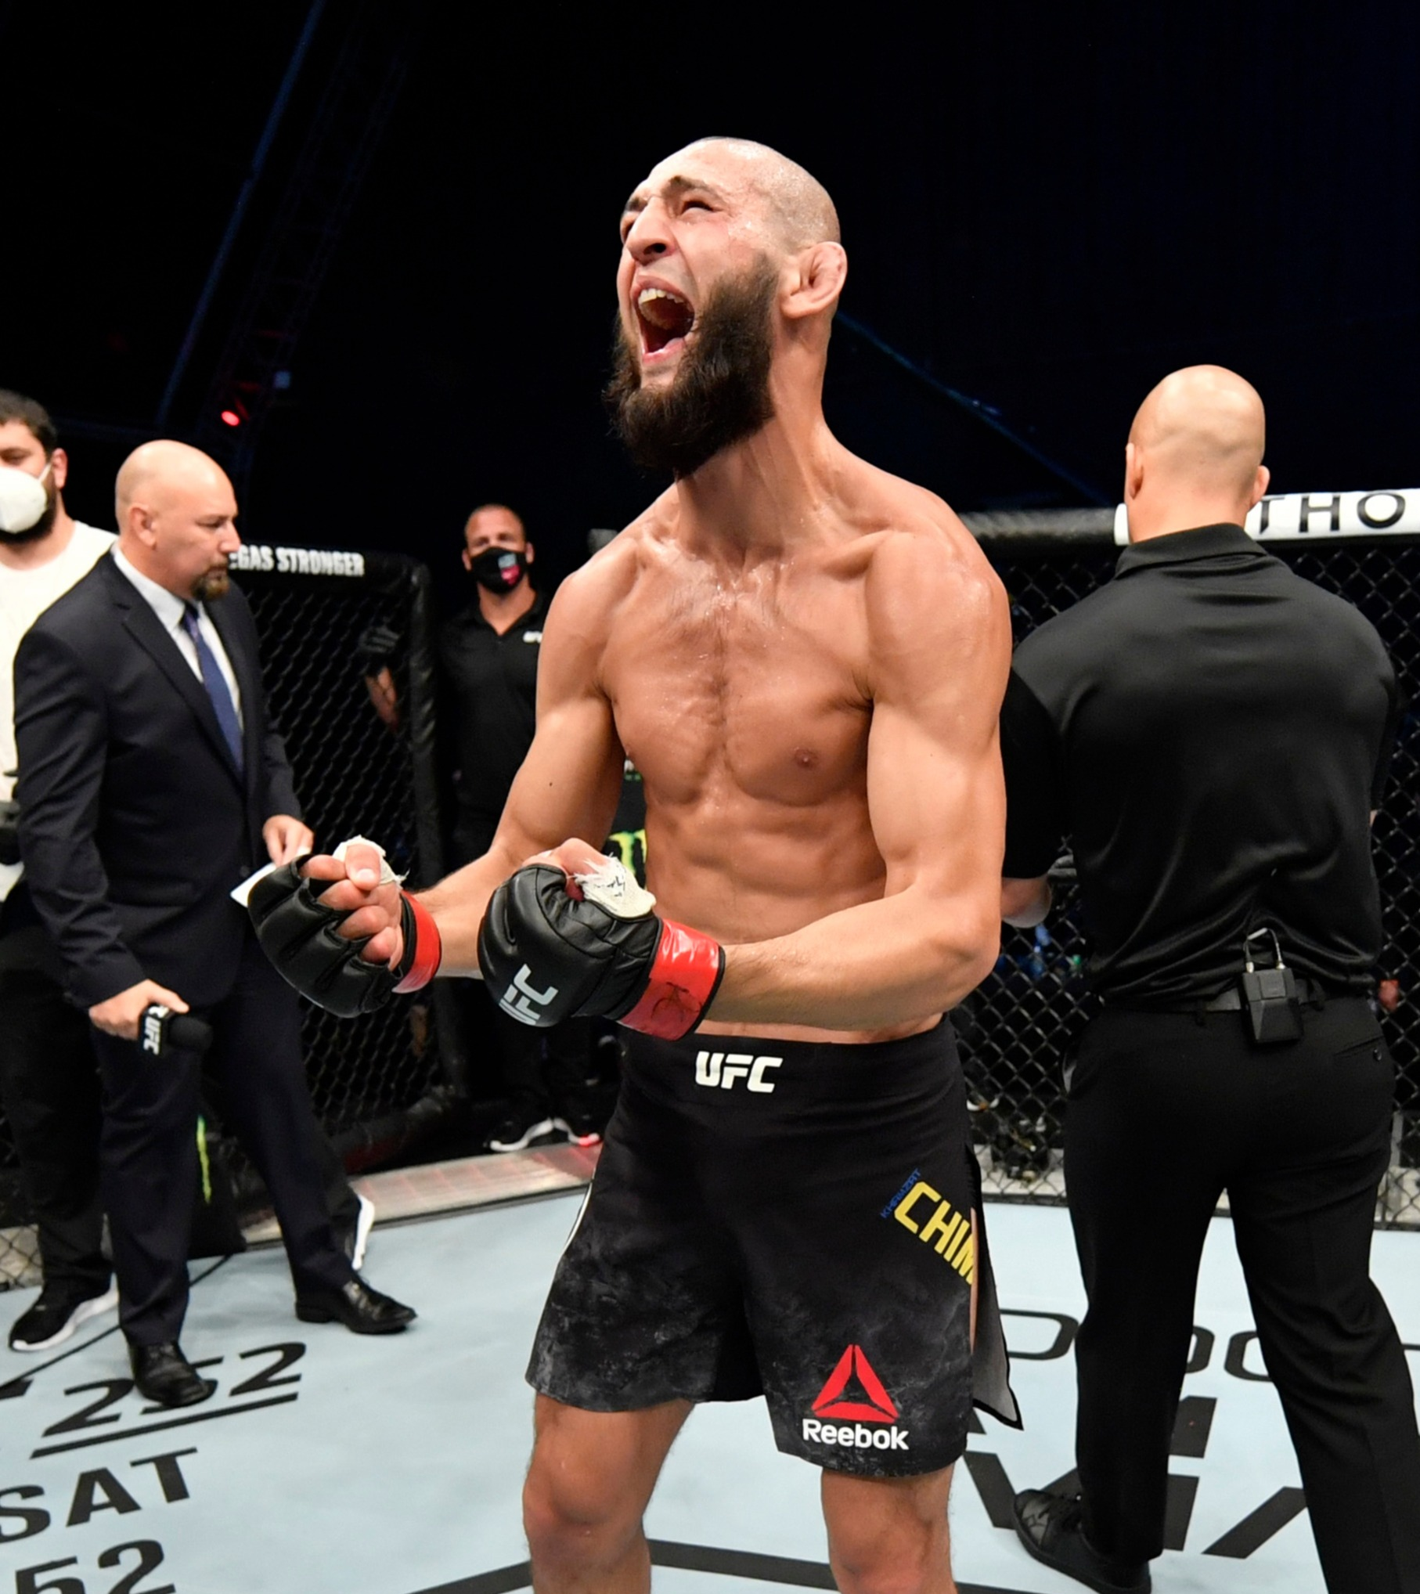
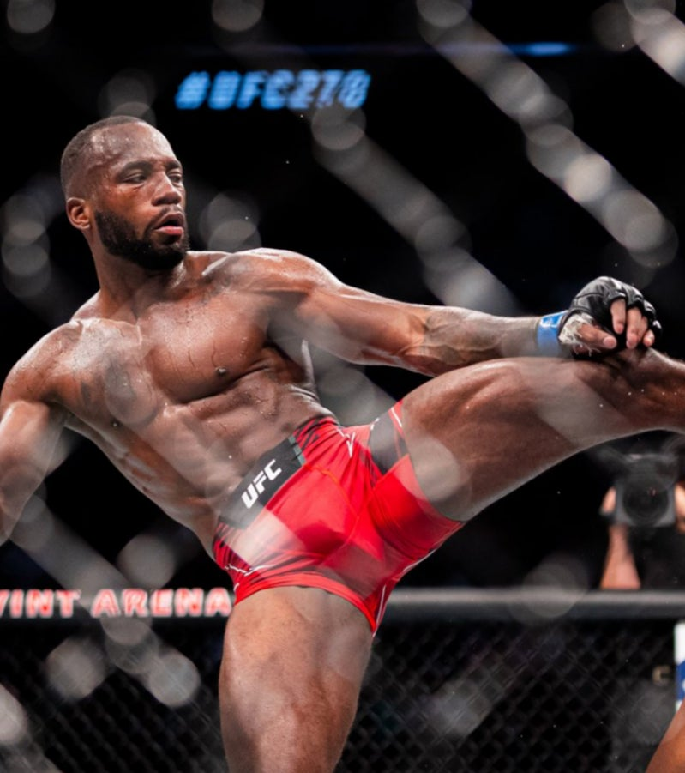
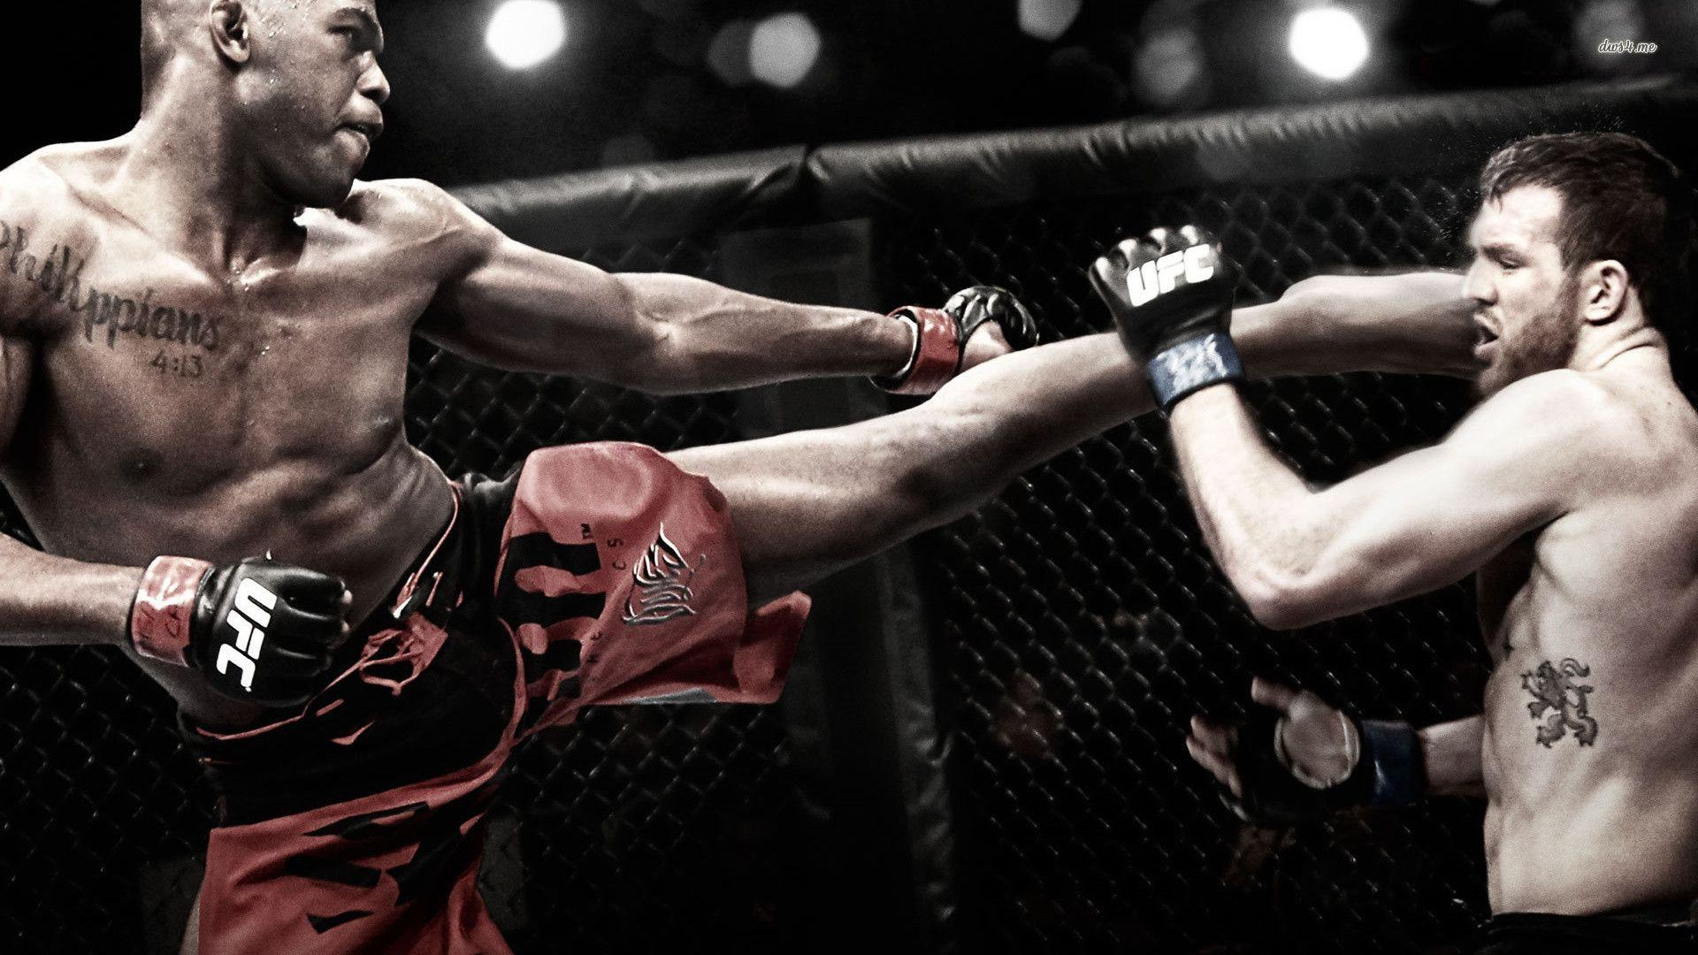
Ultimate fighting championship
The Ultimate Fighting Championship is a leading mixed martial arts organization. Founded in 1993, it's based in Las Vegas, Nevada. Fighters from around the world compete in various weight classes. Matches occur in an eight-sided cage, the Octagon. Fighters employ a range of martial arts styles, including boxing, wrestling, and jiu-jitsu. UFC events are broadcast globally, attracting millions of viewers. Champions are crowned in each weight class, with titles often changing hands as competitors rise and fall. Fans can watch events live, on TV, or on streaming platforms. The UFC has contributed significantly to MMA's worldwide popularity.

Slide 3
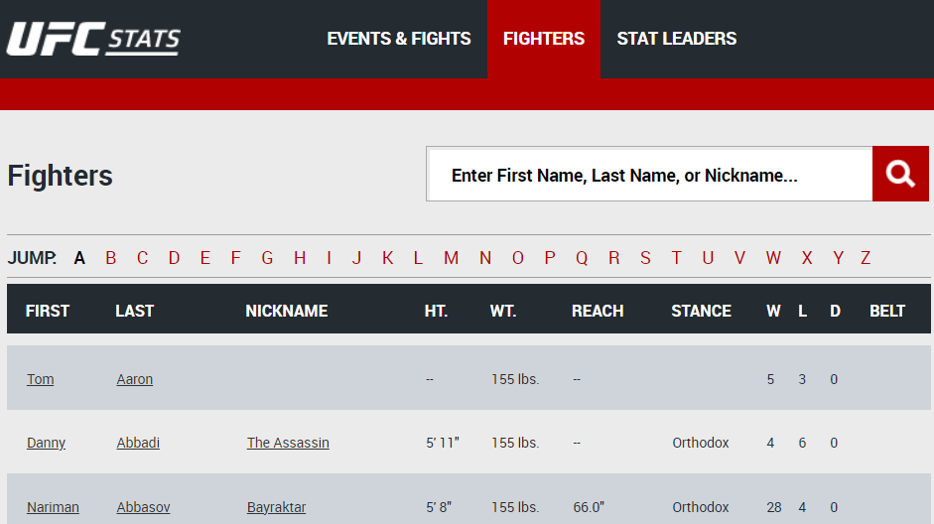
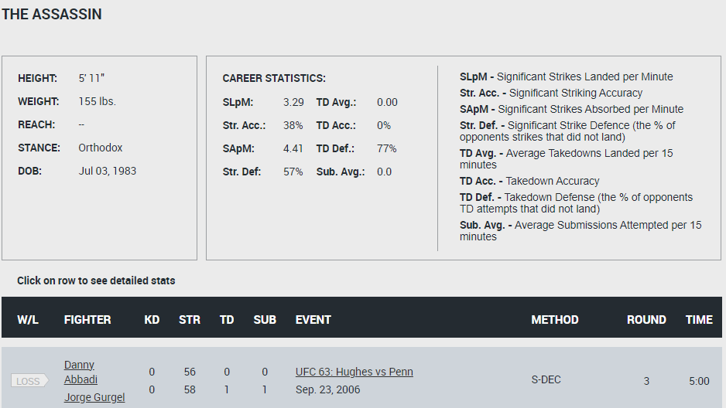
The Data
Scraped from UFCstats.com
Web scraped with Beautiful Soup

Slide 4
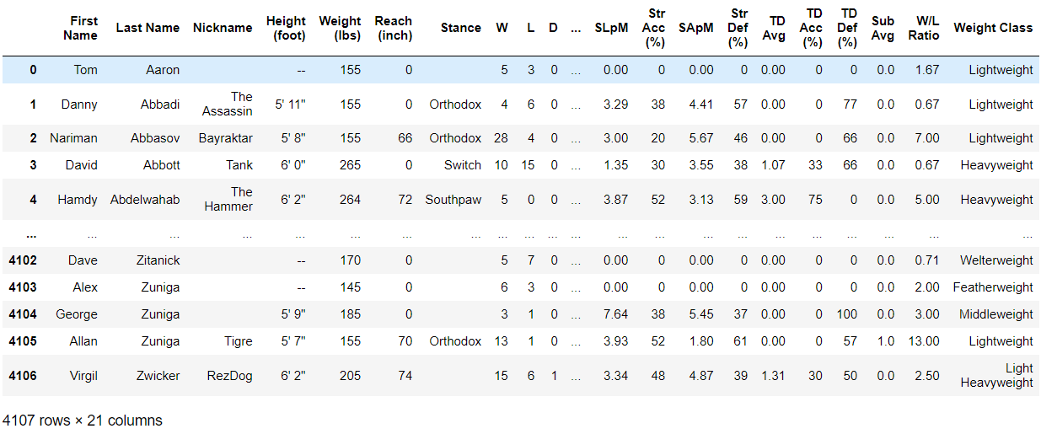
The Dataset
UFC_fighters.csv
Scraped all fighters and their individual stats
Over 4100+ pages scraped
4100+ rows | 21 columns

Slide 5
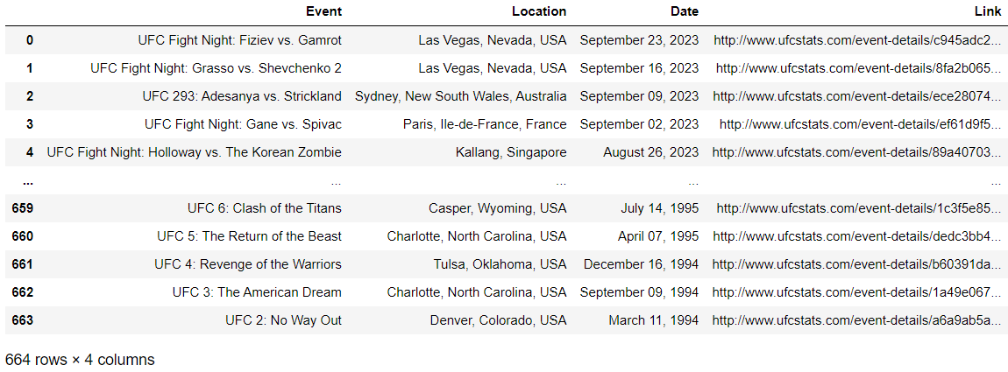
The Dataset
UFC_events.csv
Scraped all UFC events and their individual pages
Over 650+ pages scraped
650+ rows | 4 columns

Slide 6
Charts – Coming soon...

Slide 7
Discussion
Learnings
Highlights
Improvements
Web Scraping using Beautiful Soup
Learned to create datasets
Learned to manipulate HTML and CSS
Data analysis/visualization
Created UFC fighter stats dataset
Created UFC events dataset
EDA on datasets
Add more data to the fighter events dataset
Fix ‘height’ Dtype to float

Slide 8

THANK YOU!
Kevin Glugar
kevinglugar@hotmail.com
+46 73 782 00 95
LinkedIn
GitHub

